Slide 1
Project1 version presentation in class with buddy
DSI_TDA_03
Kamlarp Satchavarodom
October 2023

Slide 2
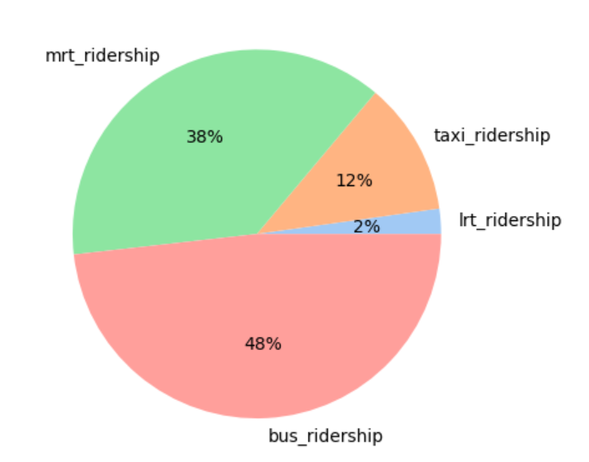
SG has 4 main public transportations; and bus is the main
Average number of passengers per day using public transport in Singapore is 6.39 millions passengers
The transport comprises of the bus, train system & taxis.
The Mass Rapid Transit (MRT) : 140 stations across six lines (48
The Light Rail Transit (LRT) : 41 stations across three lines.
The bus system is currently operated by four companies offering different types of transport services such as midnight bus service and feeder bus services that connects passengers within an estate.
The 6 taxi operators, and the taxis can be flagged along the street, at designated taxi stands or booked online.
Public Transportation breakdown by Mode

Slide 3
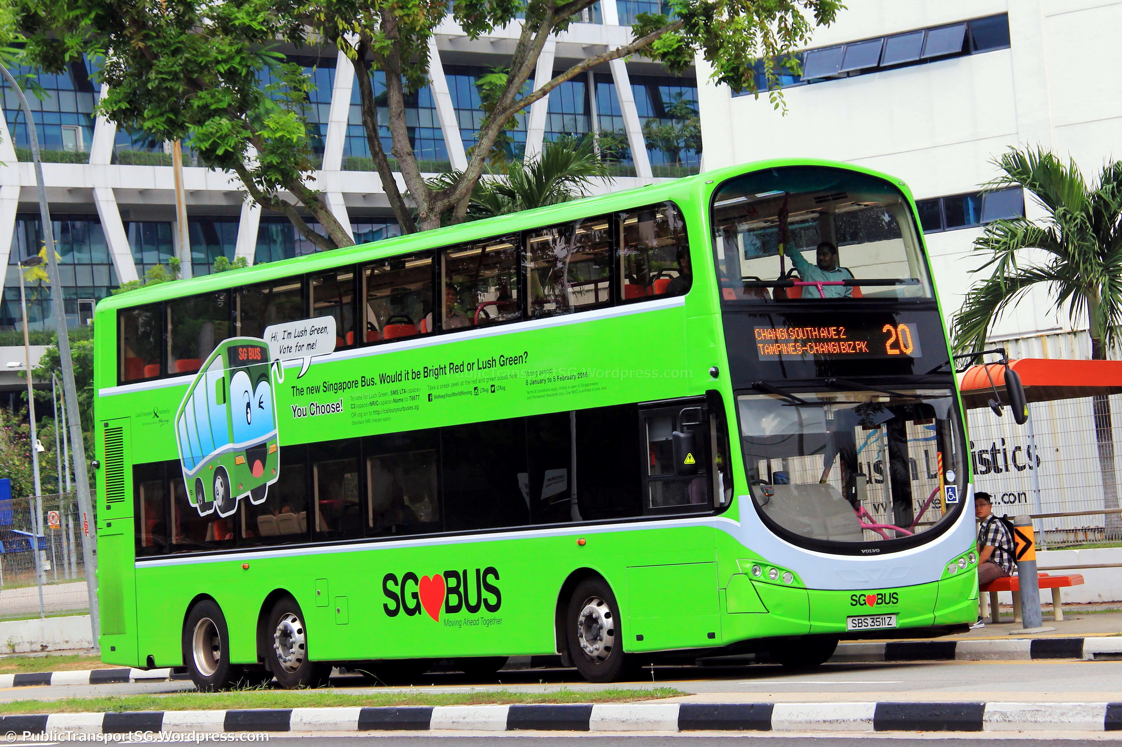
SG bus is also highly recommended transportation for tourist

Slide 4
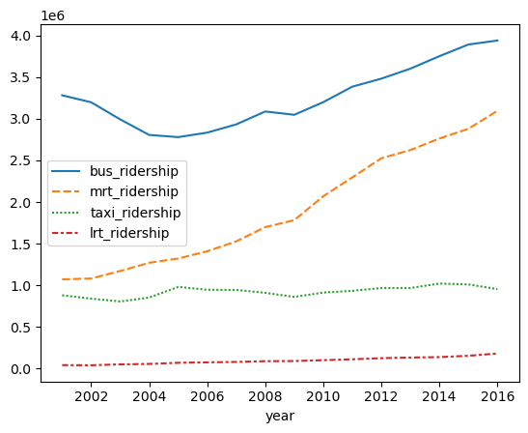
Bus and MRT usage is growing year on year
Public Transportation breakdown by Mode
Avg. Passengers per day
3,939,000
309,5000
Number of passengers
in million in average per day
954,000
180,000

Slide 5
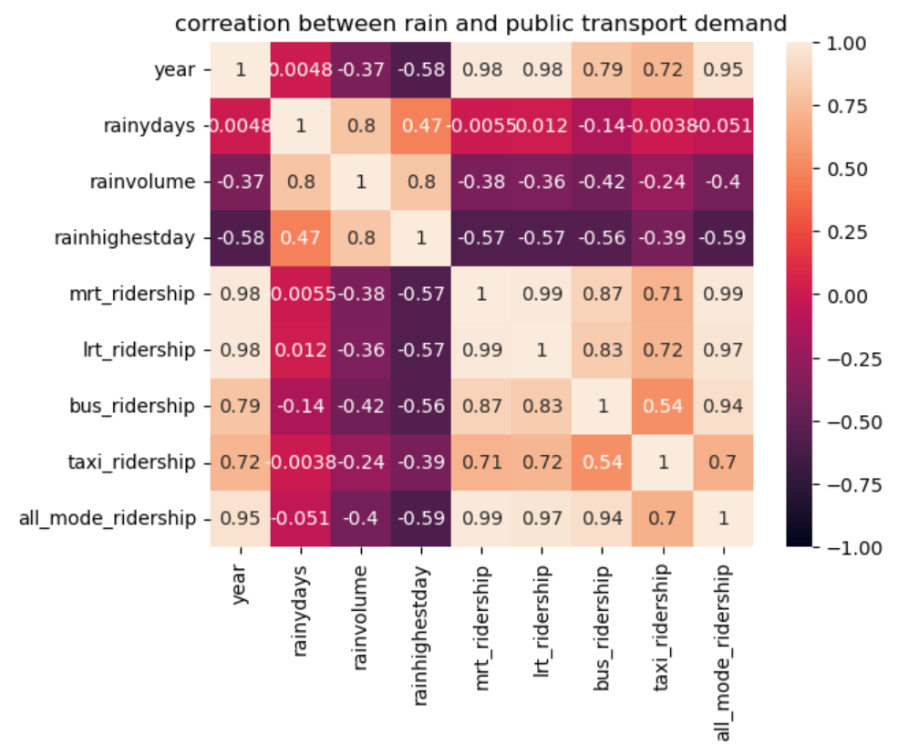
People prefer to use bus and train less while it is raining
BUS and Train has high negative correlation to the rain while has low negative correlation.
This situation be cause from the walking distance issue to the train station and bus stop

